Slide 1
Land Transport Funding in New Zealand
Barry Kidd
Acting General Manager of Road and Rail

Slide 2

Overview
National Land Transport Fund
What makes it up?
What the fund is spent on?
Other funding options
  Central government
  Local government

Slide 3
The National Land Transport Fund
FED
Fuel excise duty, which includes tax on petrol
RUC
Road user charges, paid by diesel vehicles
NLTF
MVR
Motor vehicle licensing and registration fees
Other
Interest
Sale of Land

Slide 4
Relative size of each revenue source

Slide 5
Value of the NLTF

Slide 6
Where does the money from the NLTF go?
Road Policing
FED
RUC
MVR
Other
NLTF
LT Investment
Admin

Slide 7
What is the NLTF spent on?

Slide 8
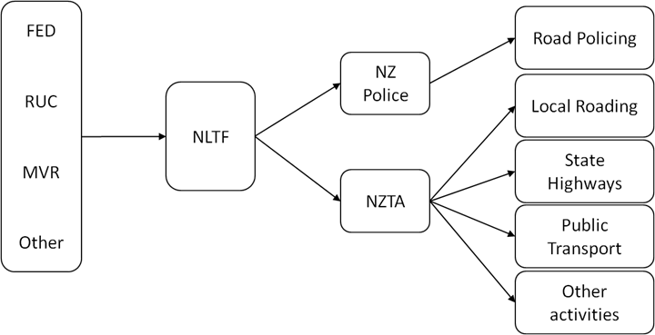
A basic Land Transport funding diagram

Slide 9
Land Transport Funding Options
NLTF
Tolling
Crown Funding

Slide 10
Local Government Funding Options
Rates
Developer Charges
Borrowing
Tax Increment Financing

Slide 11
Conclusion
Funding the priorities
Getting greater value from the spend
Recognising different perspectives

Slide 12
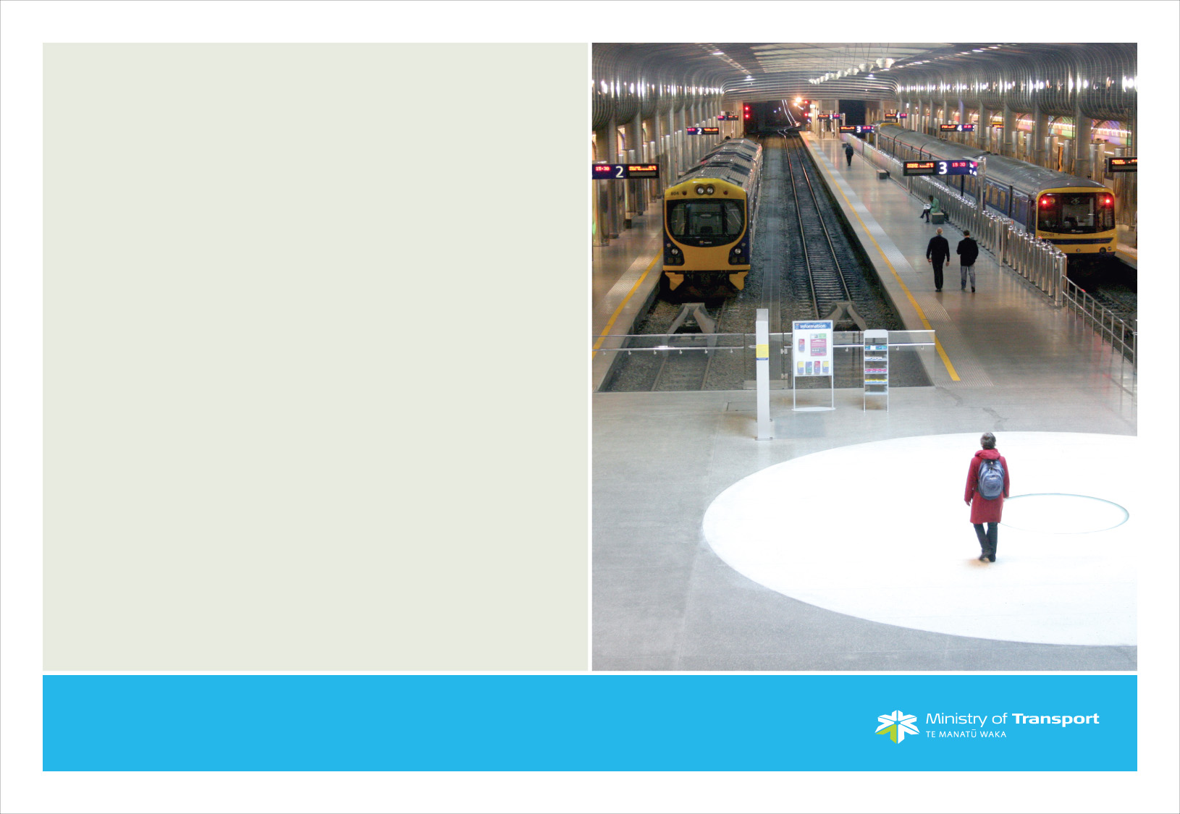
Questions?

