Slide 1
Strategic Context for Transport in New Zealand
Martin Matthews
Chief Executive
LGNZ Congress, 11 February 2011

Slide 2

Overview
Role of the Ministry
Strategic Issues:
  Economic
  People
  Energy
  Technology
  Environment
Summary
What the Ministry of Transport is focusing on

Slide 3
Role of the Ministry
To be a trusted, impartial expert adviser to government: shaping transport for New Zealand.
Providing a range of evidence based policy advice to the Minister of Transport.

Slide 4
Economic Issues
What are the patterns of New Zealand’s international and domestic economy and how do we fund the transport infrastructure and services that supports them?

Slide 5
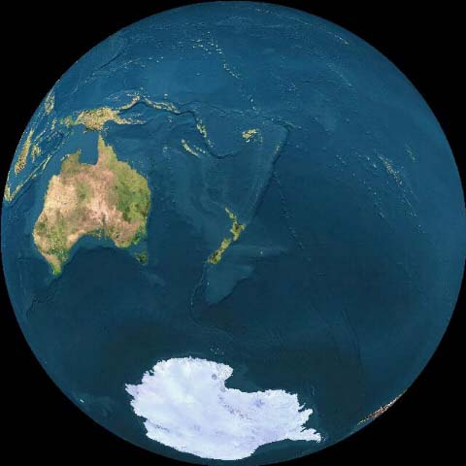
Far Away

Slide 6
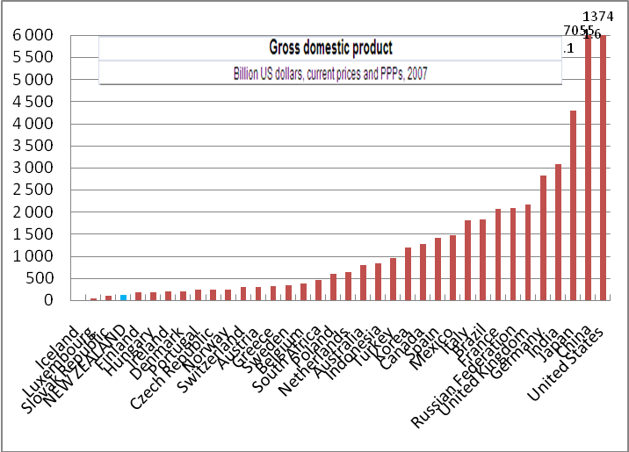
Gross Domestic Product

Slide 7
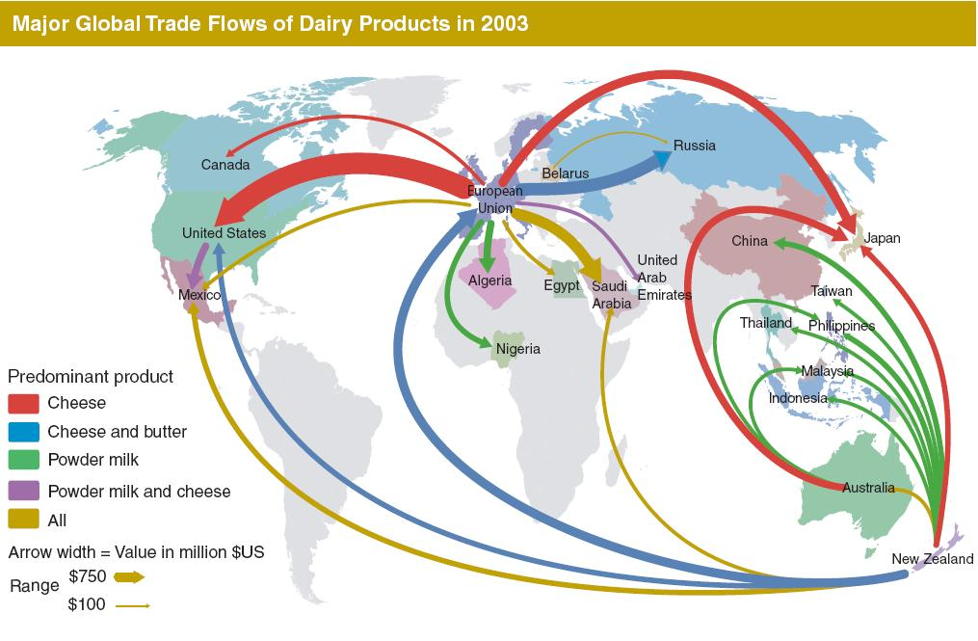
Economic Research Service, USDA, November 2005

Slide 8
Export and Import locations

Slide 9
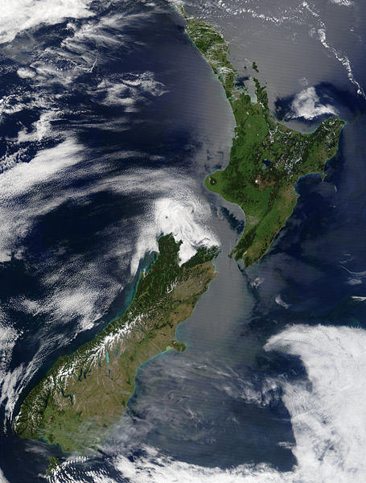
About New Zealand

Slide 10
Growth in freight flows terminating in regions

Slide 11
Growth in freight flows originating in regions
NFDS 2008

Slide 12
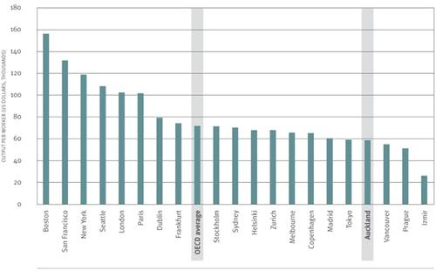
Labour productivity
OECD Territorial Reviews: Competitive Cities in the Global Economy, 2006

Slide 13
People Issues
What is happening to New Zealand’s population (growing, ageing, diversifying, and becoming more urbanised) and what will the impact of their choices will be on the transport system?

Slide 14
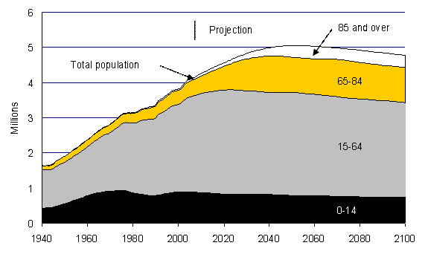
Population growth and changes
www.treasury.govt.nz

Slide 15
How people may travel in the future?
Ministry of Transport analysis

Slide 16
Population growth to 2031
Statistics NZ projections June 2009

Slide 17
Energy Issues
How do we enable the mobility that New Zealanders require in an environment of both increasing fuel prices and price volatility?

Slide 18
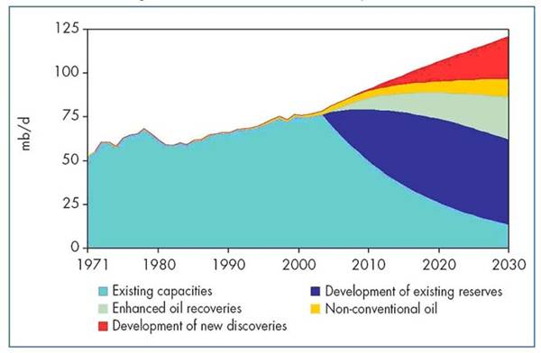
Future sources of oil
2004 World Energy Outlook

Slide 19
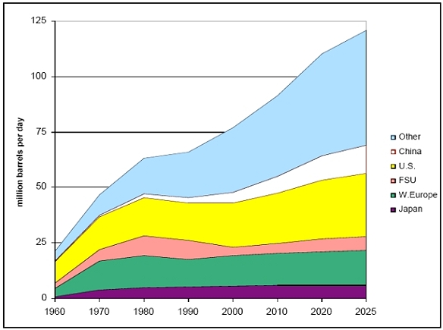
Energy demand by fuel type
U.S. Energy Department

Slide 20
Environment Issues
What effect does transport have on the environment and conversely how will that impact on New Zealand’s transport system?

Slide 21
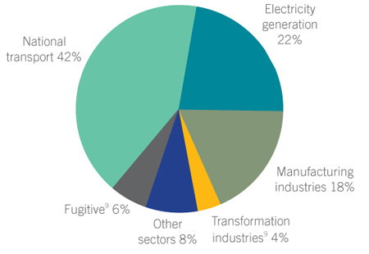
Energy emissions by sector
www.med.govt.nz

Slide 22
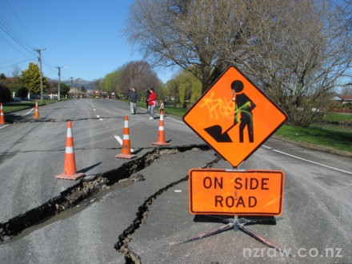
Resilience

Slide 23
Technology Issues
How do we capture the benefits of technology to improve the transport system as quickly and easily as possible?

Slide 24
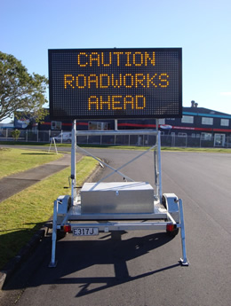
The role of technology

Slide 25
Summary
The key issues facing transport include:
  Economic
  People
  Energy Funding
  Environment
  Technology

Slide 26
What the Ministry of Transport is focusing on
Identification, collection and monitoring of key datasets
Forward Plan for transport 2011
Trends and issues workshops 2011
Scenario development 2011
  National Infrastructure Plan 2 2011
  Government Policy Statement 2012

Slide 27

Questions?

